Slide 1
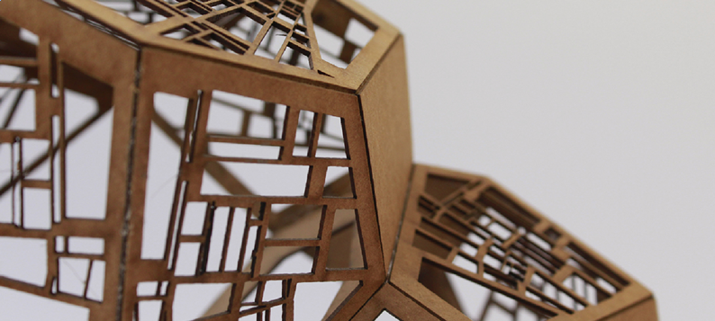
^{SEMINARIOS}
^{MAGÍSTER EN CIENCIAS} ^{DEL DISEÑO}
^{“Makers contra el COVID”}
^{MONDAY JANUARY 13TH,}
^{11:30AM - 12:40PM}
Room 112-D (live broadcasting: iUAI Systems Center YouTube channel)
^{INSCRÍBETE AQUÍ}
Symmetry breaking inequalities are a common technique in the toolbox of integer programming. They are heavily used in practice as they can yield a vital improvement while running standard algorithms as Branch and Bound. On the other hand, our knowledge regarding techniques to automatically break symmetries in general problems is still lacking. Moreover, the theoretical implications of how different techniques affect the resulting formulation are not well understood.
^{INVITADOS}
^{Profesor XXX}
^{Universidad Adolfo Ibáñez}
^{Profesor XXX}
^{Universidad Adolfo Ibáñez}
^{Profesor XXX}
^{Universidad Adolfo Ibáñez}
^{Profesor XXX}
^{Universidad Adolfo Ibáñez}
^{CONTACTO:}
^{xxx@uai.cl}
⁽⁺⁵⁶ ²⁾ ²³³¹ ¹⁴⁹⁵
^{DESIGNLAB.UAI.CL}

Slide 2
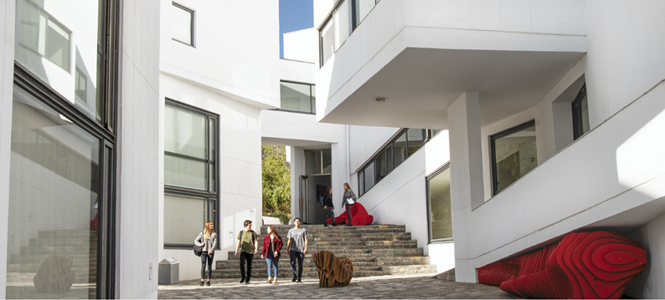
^{SEMINARIOS}
^{MAGÍSTER EN CIENCIAS} ^{DEL DISEÑO}
^{“Makers contra el COVID”}
^{MONDAY JANUARY 13TH,}
^{11:30AM - 12:40PM}
Room 112-D (live broadcasting: iUAI Systems Center YouTube channel)
^{INSCRÍBETE AQUÍ}
Symmetry breaking inequalities are a common technique in the toolbox of integer programming. They are heavily used in practice as they can yield a vital improvement while running standard algorithms as Branch and Bound. On the other hand, our knowledge regarding techniques to automatically break symmetries in general problems is still lacking. Moreover, the theoretical implications of how different techniques affect the resulting formulation are not well understood.
^{INVITADOS}
^{Profesor XXX}
^{Universidad Adolfo Ibáñez}
^{Profesor XXX}
^{Universidad Adolfo Ibáñez}
^{Profesor XXX}
^{Universidad Adolfo Ibáñez}
^{Profesor XXX}
^{Universidad Adolfo Ibáñez}
^{CONTACTO:}
^{xxx@uai.cl}
⁽⁺⁵⁶ ²⁾ ²³³¹ ¹⁴⁹⁵
^{DESIGNLAB.UAI.CL}

Slide 3
